Slide 1
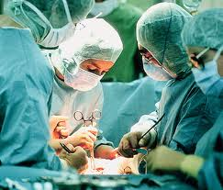
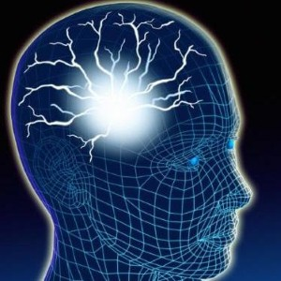
Neurological Disorders Lesson 4.6
What causes epilepsy?

Slide 2
Do Now:
Examine the circuit below. The two red neurons are excitatory and the two blue neurons are inhibitory.
What effect would removing the two blue inhibitory neurons have on this circuit’s activity?
+
+
-
-

Slide 3
Removing Inhibition: The Effect Locally
X
X
+
+
-
-

Slide 4
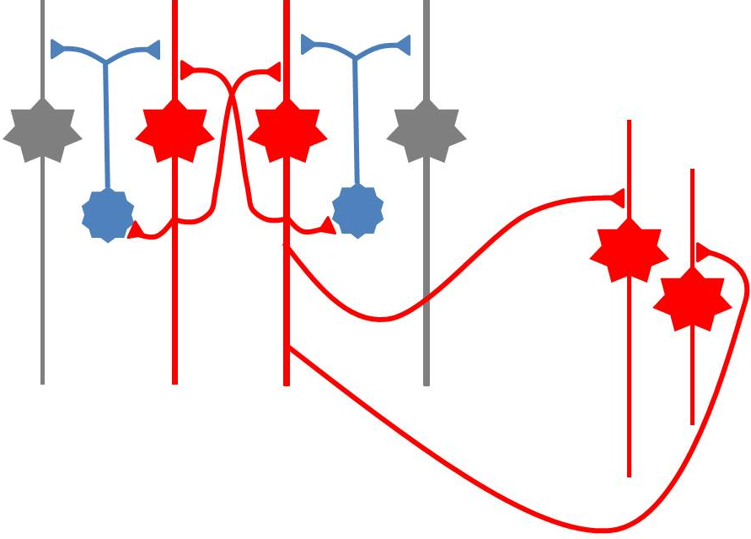
Removing Inhibition: The Effect Distantly
Local
X
X
Distant
+
+
-
-
+
+

Slide 5
Can anyone think of a condition caused by abnormal disordered neuronal activity?

Slide 6
Epilepsy
Chronic neurological condition that results in unprovoked seizures.
Seizures are the changes in behavior caused by disordered abnormal electrical activity in the brain.

Slide 7
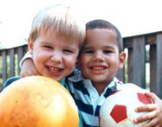
Symptoms of Seizure
Positive
Acquiring an abnormal behavior
Ex. Jerking an arm
Negative
Losing a normal behavior
Ex. Temporary loss of sight
Normal Vision
Loss of Vision

Slide 8
Symptoms of Seizure
Somatosensory
Motor in limbs
Visual
Motor in face and head
Auditory

Slide 9
Types of Seizures
Partial Seizures
Occur when abnormal electrical activity remains in a limited area of the brain
Generalized Seizures
Occur when abnormal electrical activity extends throughout the entire brain

Slide 10
Partial Seizure
Originate within a small group of neurons called a seizure focus
Start due to loss of inhibitory control
Seizure Focus

Slide 11
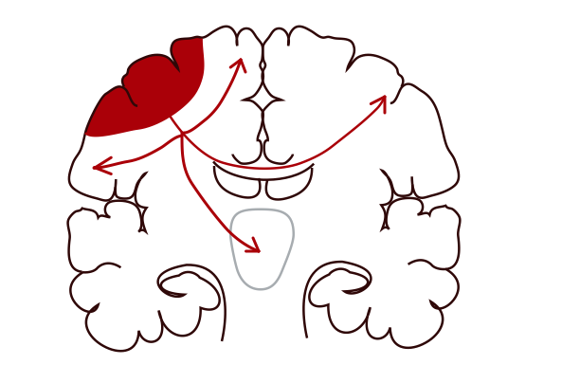
Partial Seizure: Spread from Seizure Focus
Seizure Focus
Thalamus

Slide 12
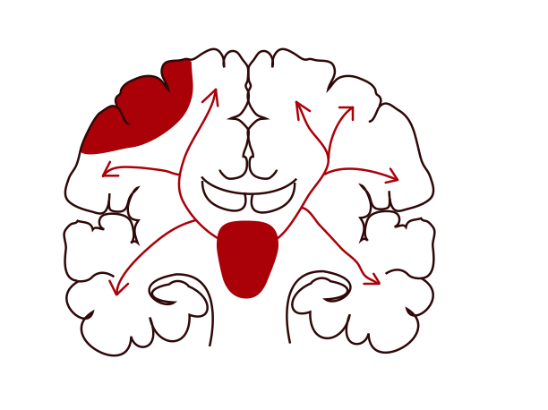
Partial Seizure: Spread from Seizure Focus
Seizure Focus
Thalamus

Slide 13
Generalized Seizures
Originate within the thalamus
Start simultaneously in both sides of the brain
Thalamus

Slide 14
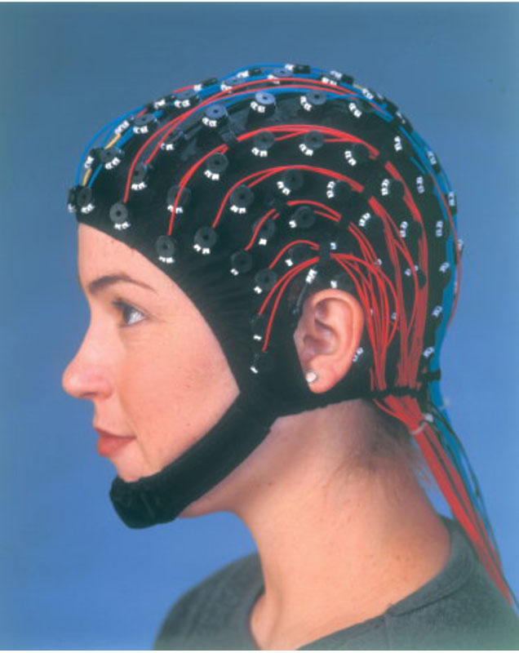
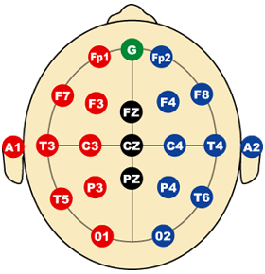
Measuring Seizures
EEG measures the electrical activity of the brain.

Slide 15
Measuring Seizures
EEG measures the electrical activity of the brain.
Placement of Electrodes
F – Frontal Lobe
T – Temporal Lobe
P – Parietal Lobe
O – Occipital Lobe
C – Motor Cortex
Number system
Odd – Left hand side
Even – Right hand side

Slide 16
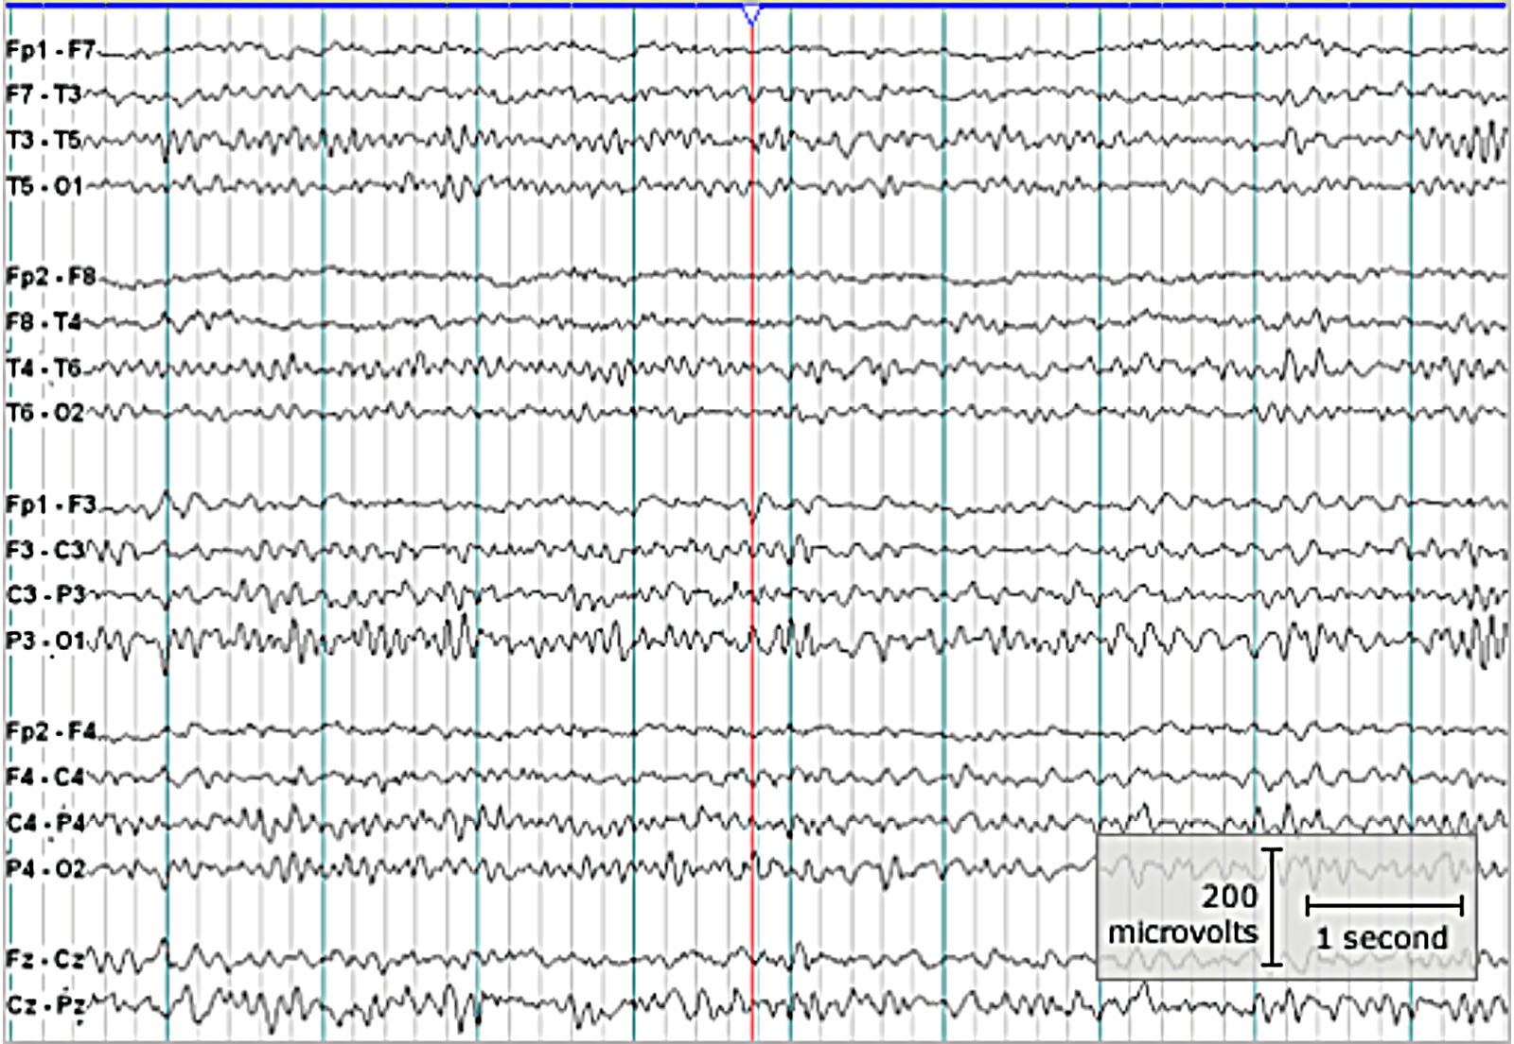
Measuring Seizures
EEG measures the electrical activity of the brain.

Slide 17
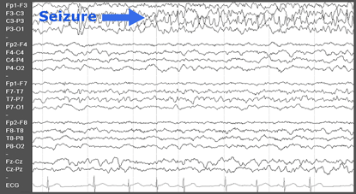
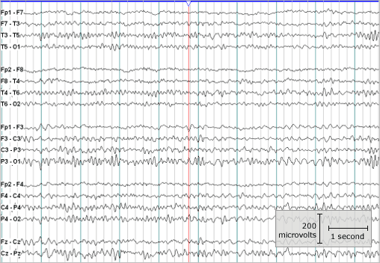
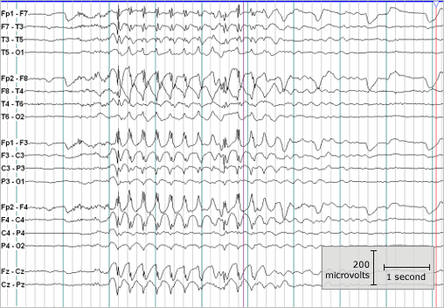
Measuring Seizures
Partial Seizure
Normal
Generalized Seizure

Slide 18
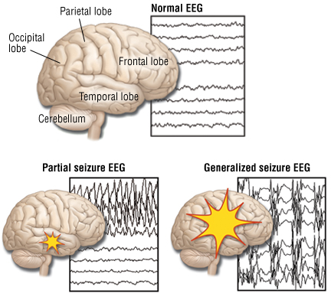
Analyzing EEGs

Slide 19
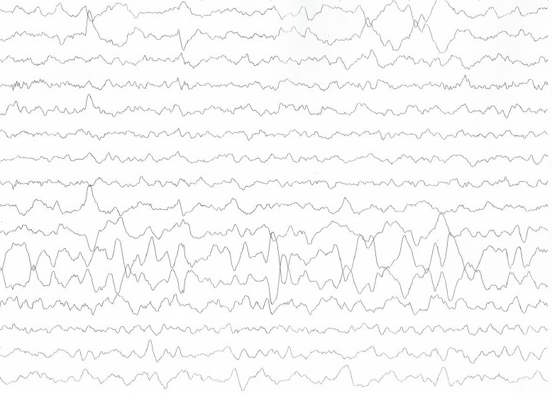
Patient 1
FP2-F8
F8-T4
T4-P6
P6-O2
FP2-F2
F4-C2
C4-P4
P4-O4
FP1-F7
F7-T3
T3-T5
T5-O1
FP1-F3
F3-C3
C3-P3
P3-O1

Slide 20
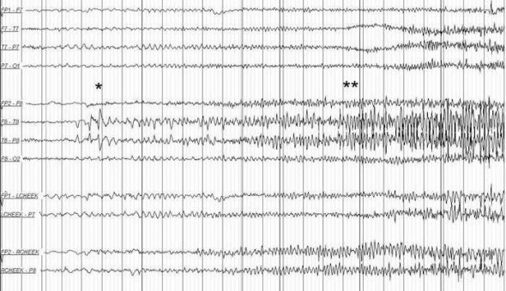
Patient 2
FP1-F7
F7-T7
T7-P7
P7-O1
FP2-F8
F8-T8
T8-P8
P8-O2
FP1-LCheek
LCheek –P1
FP2-RCheek
RCheek –P2

Slide 21
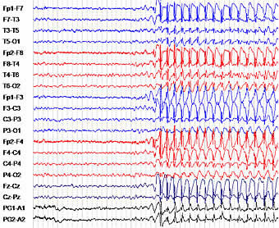
Patient 3

Slide 22
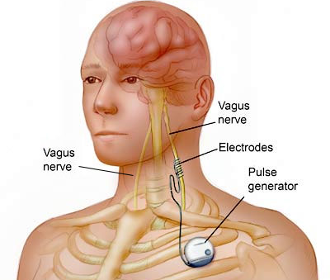
Treatment
Vagus Nerve Stimulation
Medicines
Surgery

